Slide 1

Health Professional
Department of Biology

Slide 2
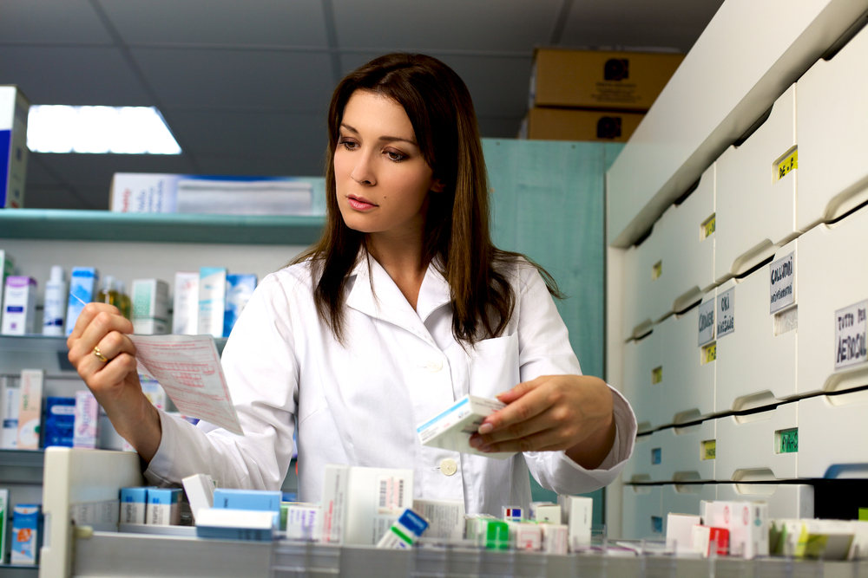
Pharmacist
Department of Chemistry and Biochemistry

Slide 3

Computer Programmer
Department of Computer Science

Slide 4
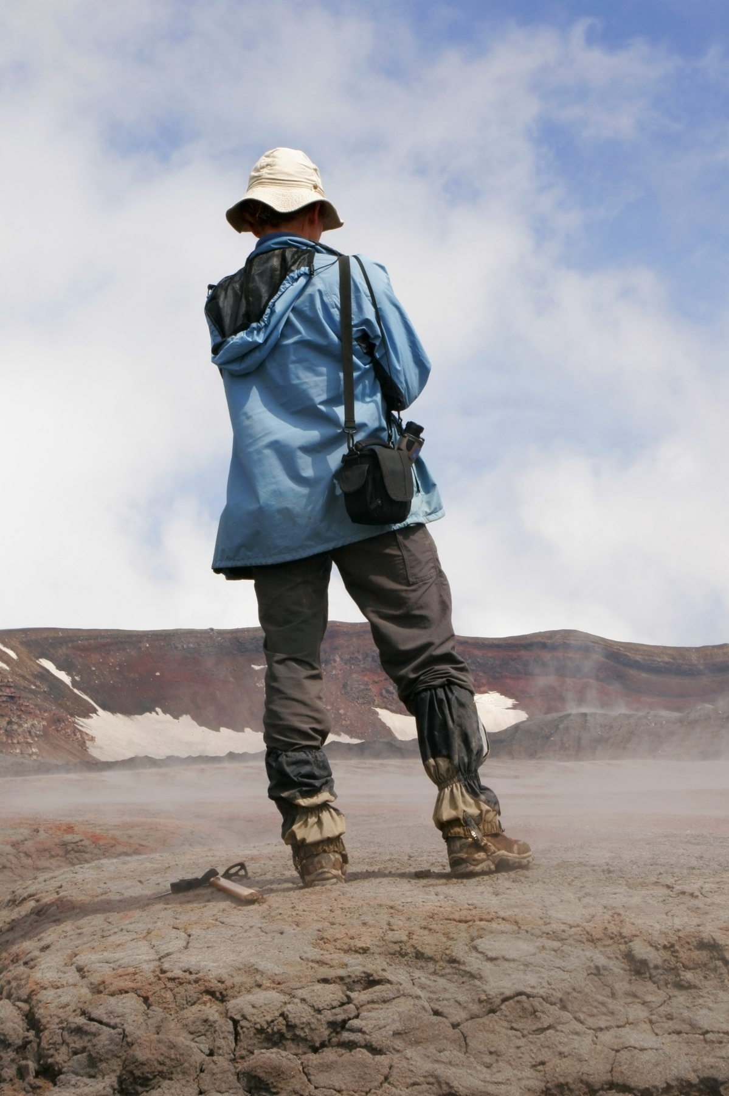
Geologist
Department of Geology

Slide 5

Financial Analyst
Department of Mathematics and Statistics

Slide 6
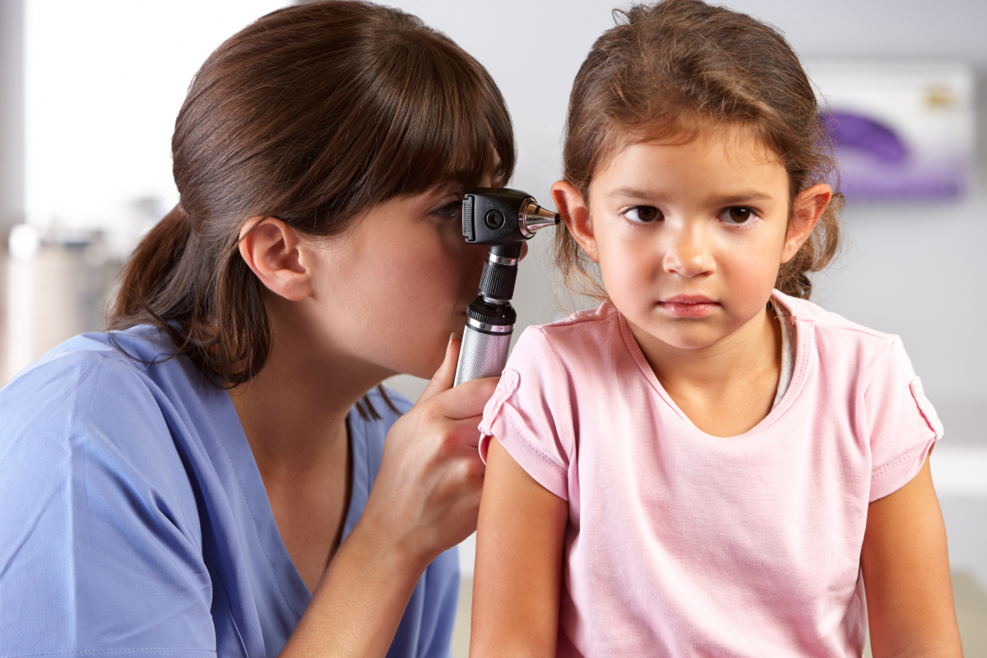
Pediatric
School of Nursing

Slide 7
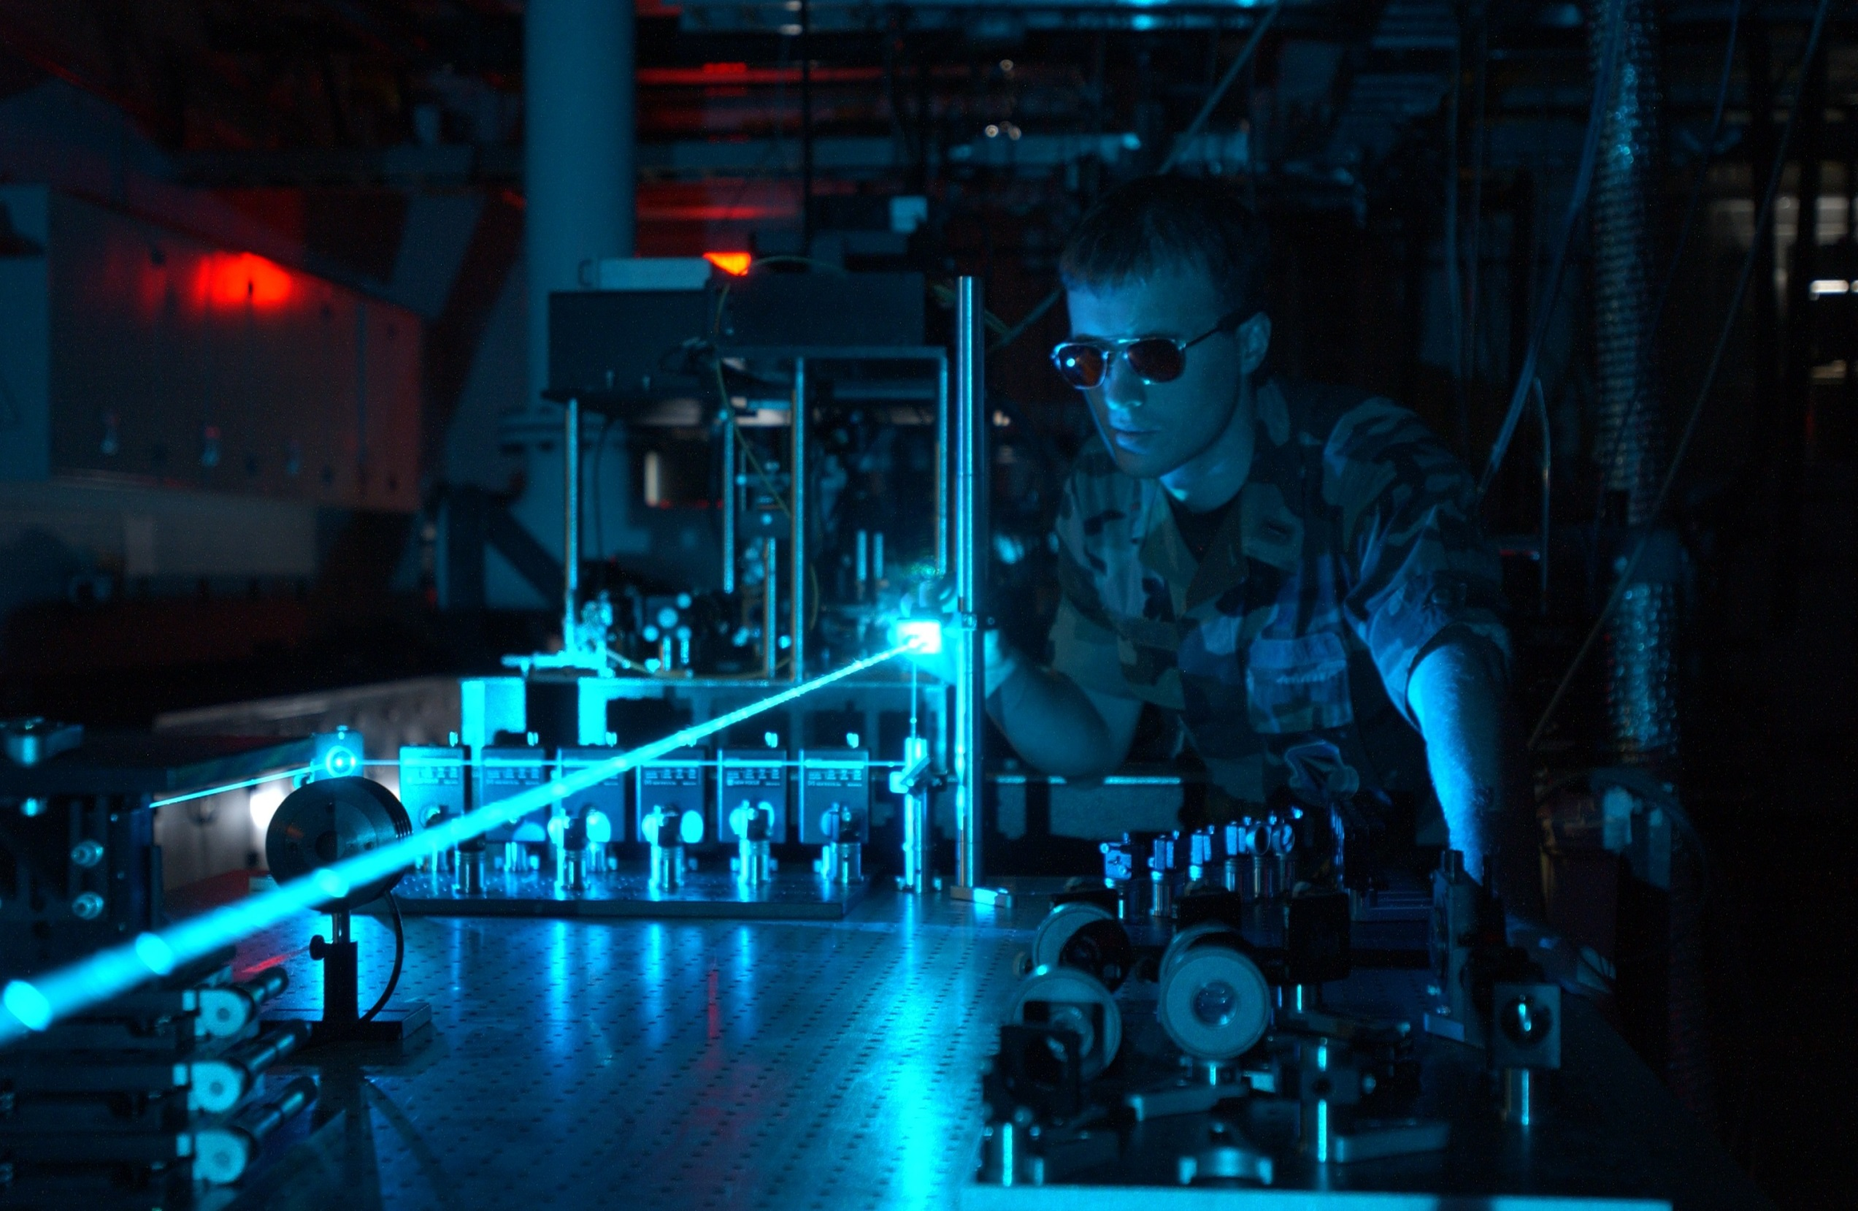
Physicist
Department of Physics and Astronomy

Slide 8
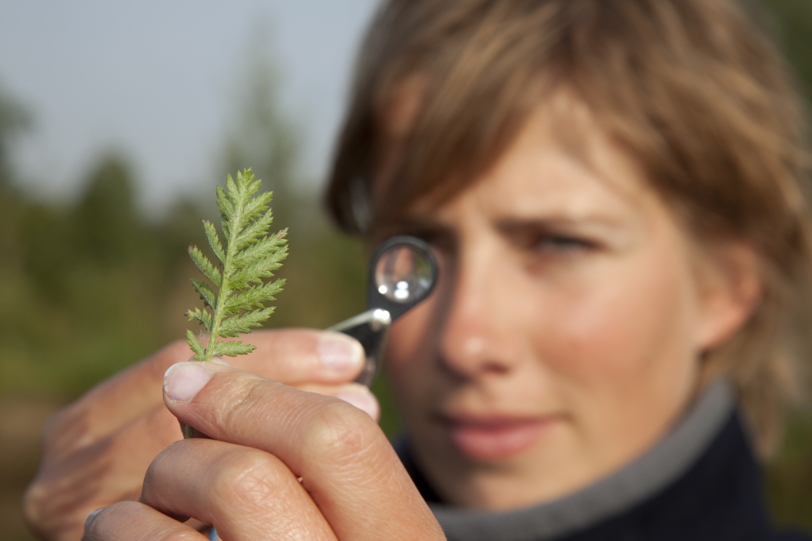
Ecologist
Department of Biology

Slide 9
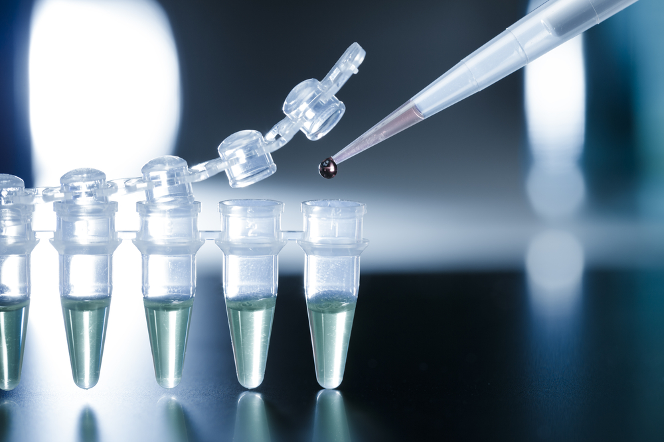
Chemical Consultant
Department of Chemistry and Biochemistry

Slide 10
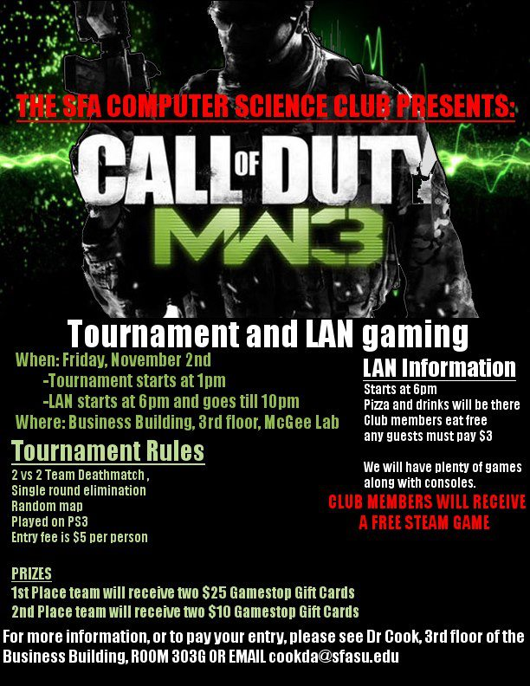
Video Game Designer
Department of Computer Science

Slide 11

Oil and Gas
Department of Geology

Slide 12
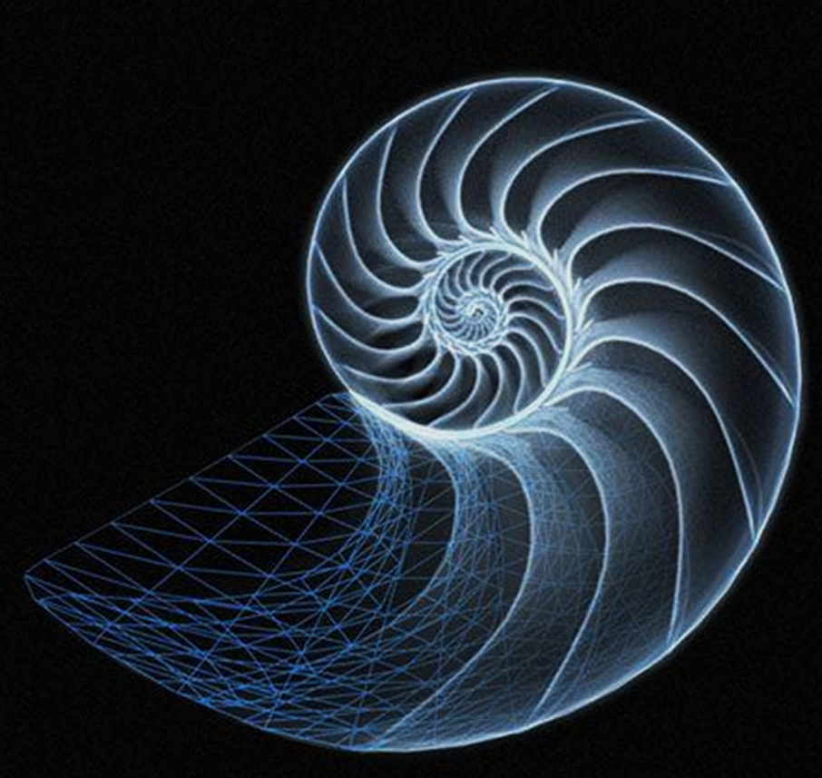
Biomathematician
Department of Mathematics and Statistics

Slide 13

Obstetrical
School of Nursing

Slide 14
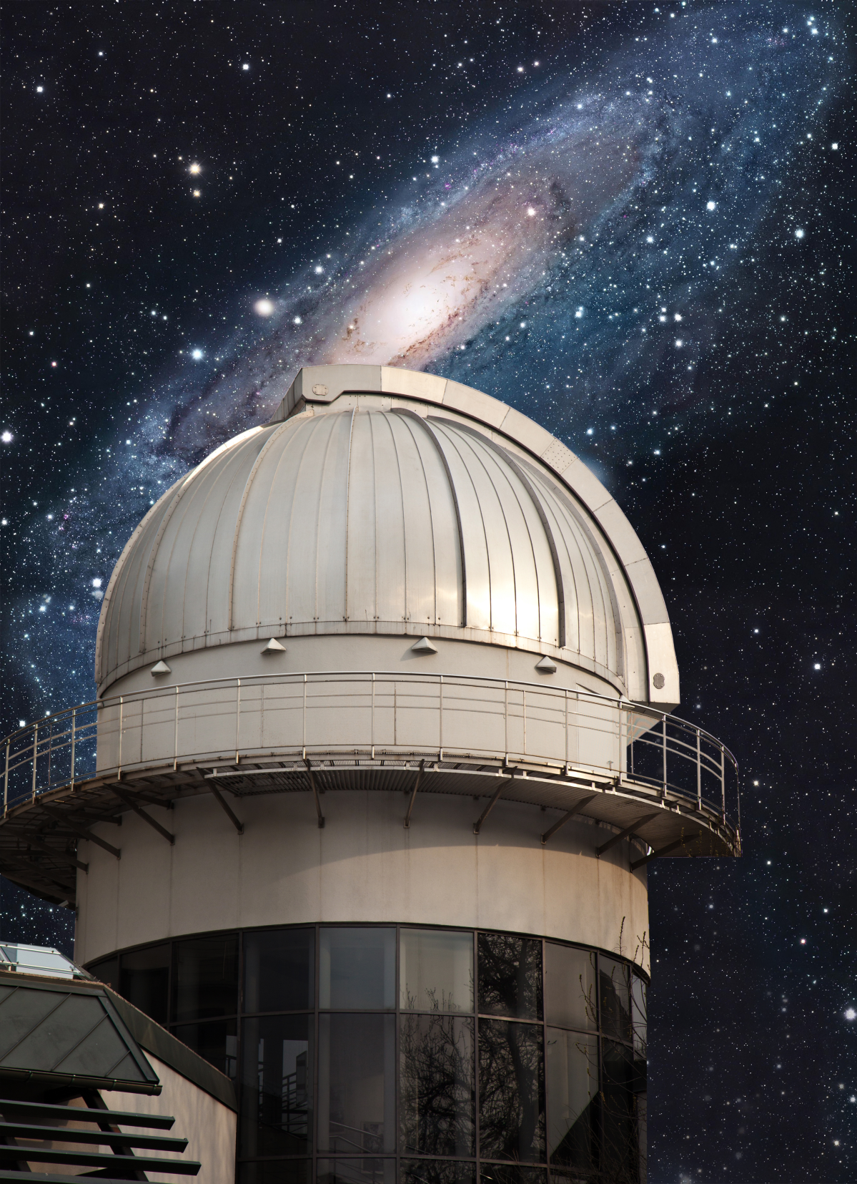
Astronomer
Department of Physics and Astronomy

Slide 15

Genetic Engineer
Department of Biology

Slide 16
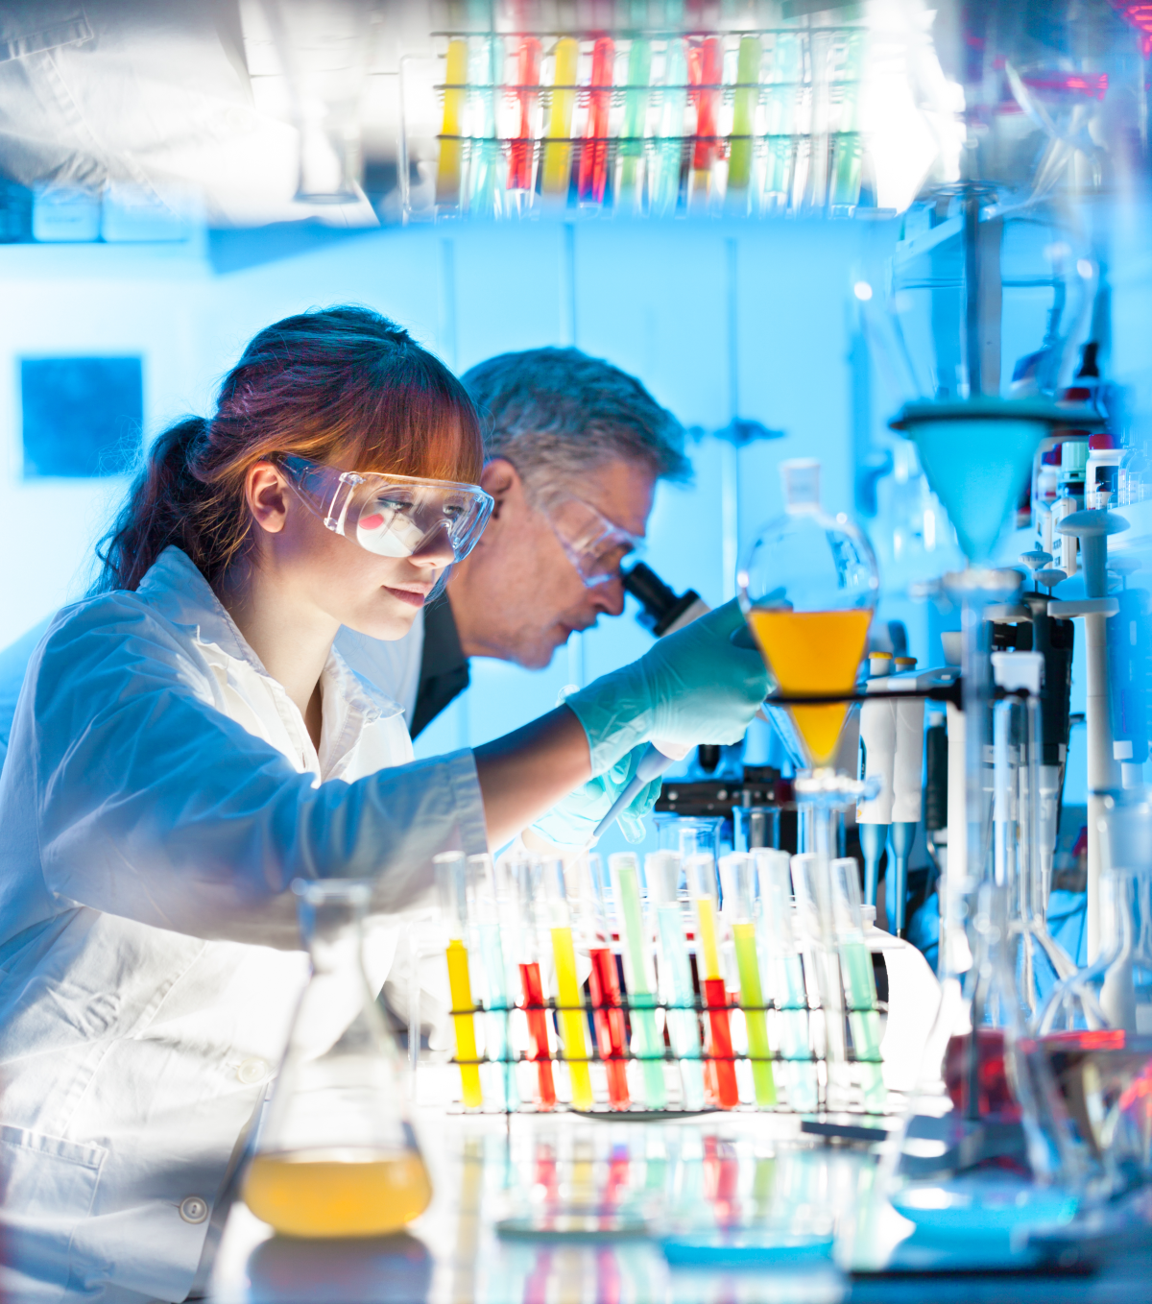
Forensic Scientist
Department of Chemistry and Biochemistry

Slide 17

Database Administrator
Department of Computer Science

Slide 18
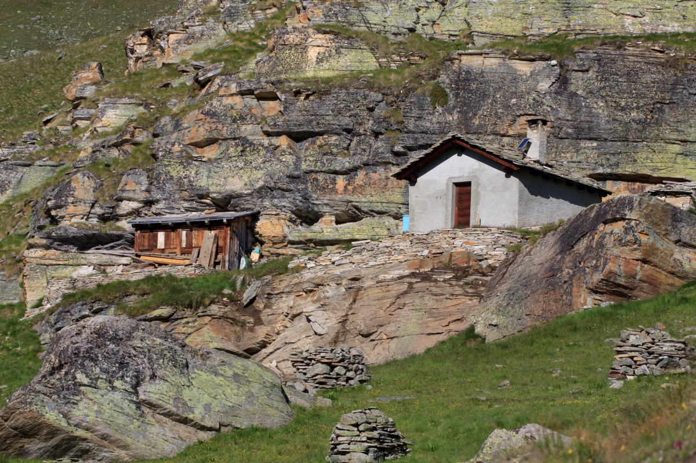
Park Ranger
Department of Geology

Slide 19

Statistician
Department of Mathematics and Statistics

Slide 20
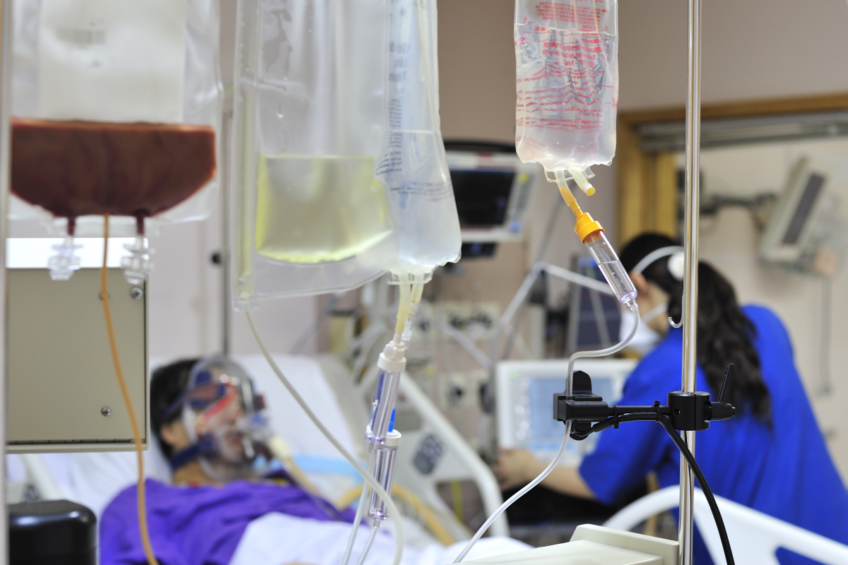
Critical Care
School of Nursing

Slide 21
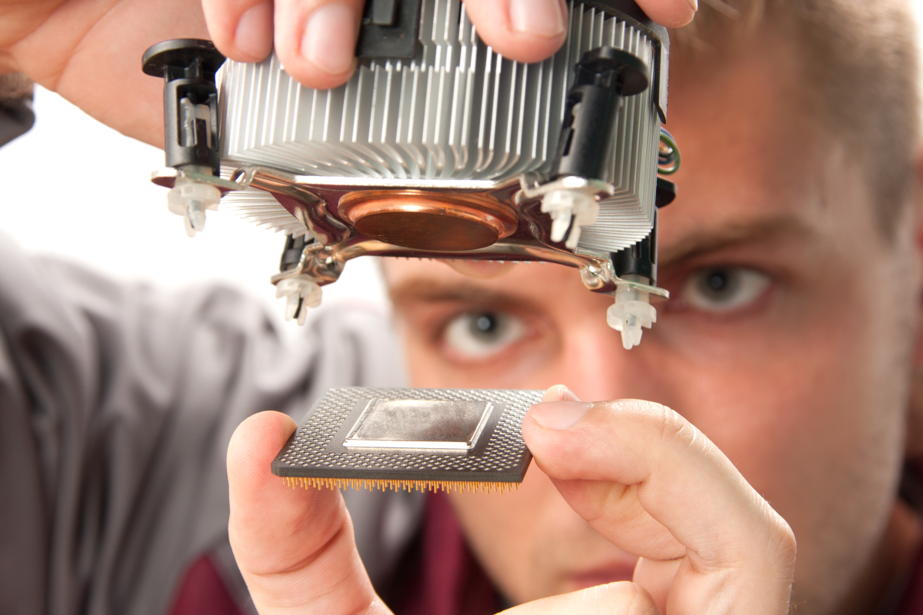
Engineer
Department of Physics and Astronomy

Slide 22

Student Organizations

Slide 23
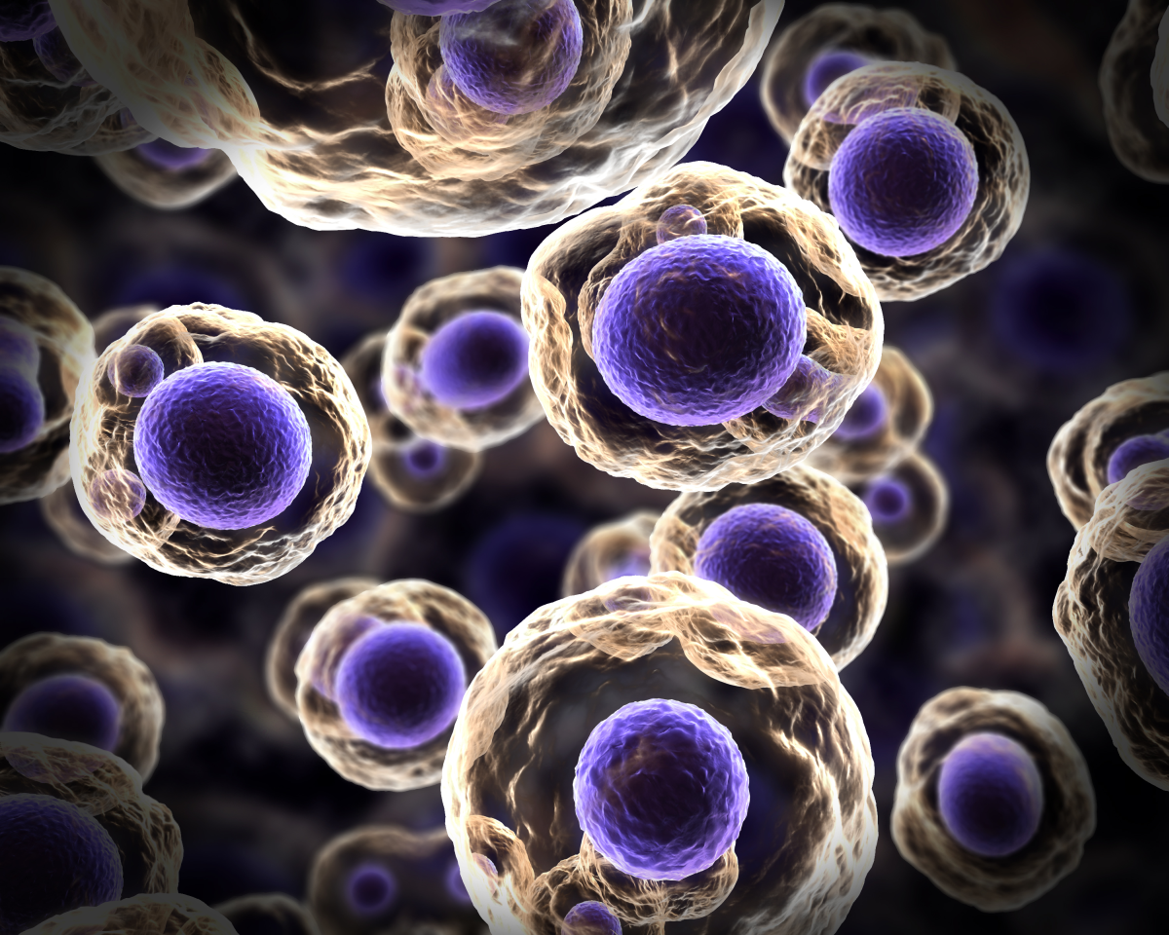
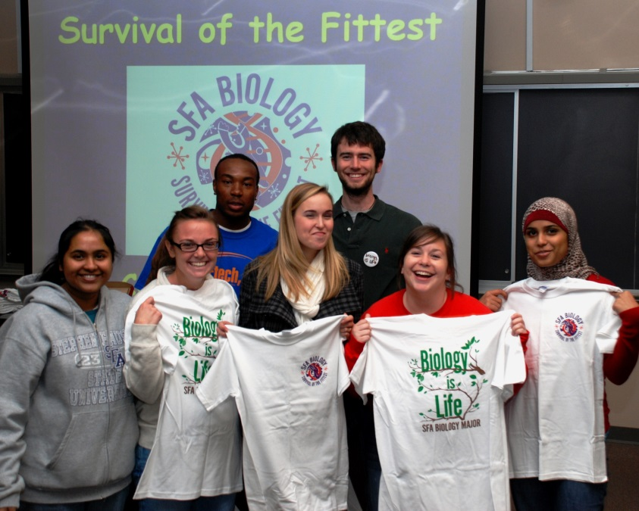
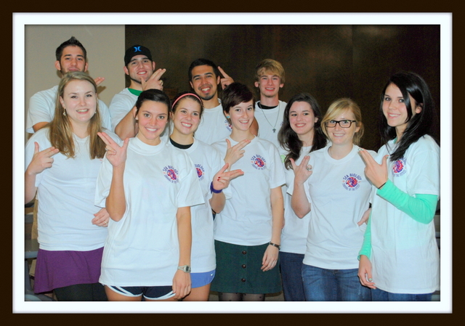
Biology Club
Department of Biology
Next Meeting: Tues, Sep 10 @ 6pm Miller 139

Slide 24

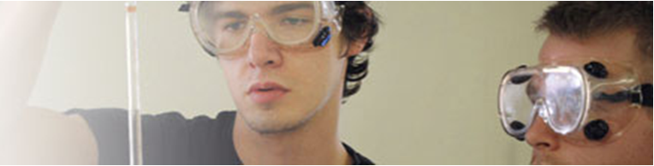
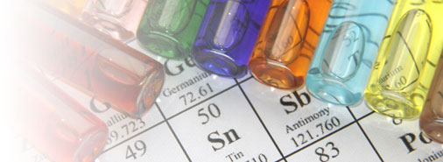
Chemistry Club
Department of Chemistry and Biochemistry
Next Meeting: Thurs, Sep 12, Chemistry 106

Slide 25
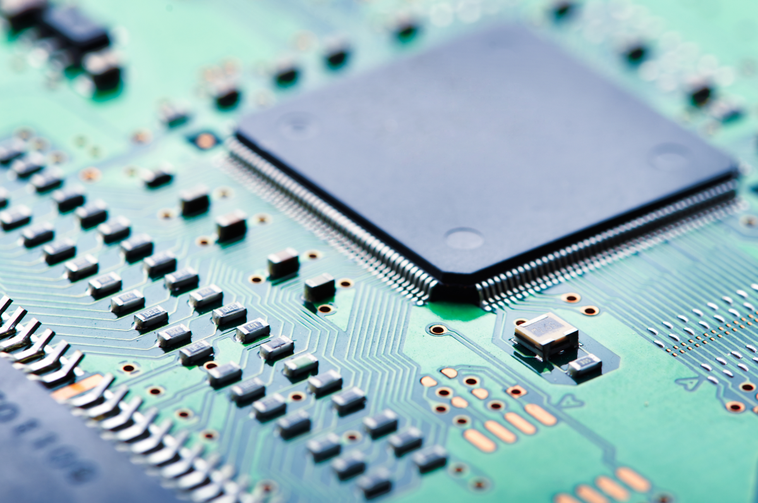
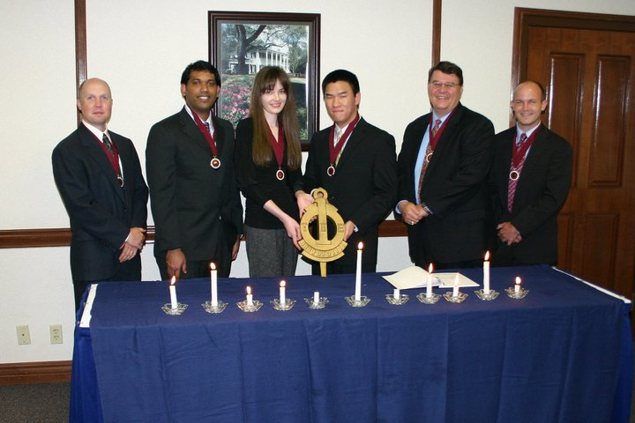
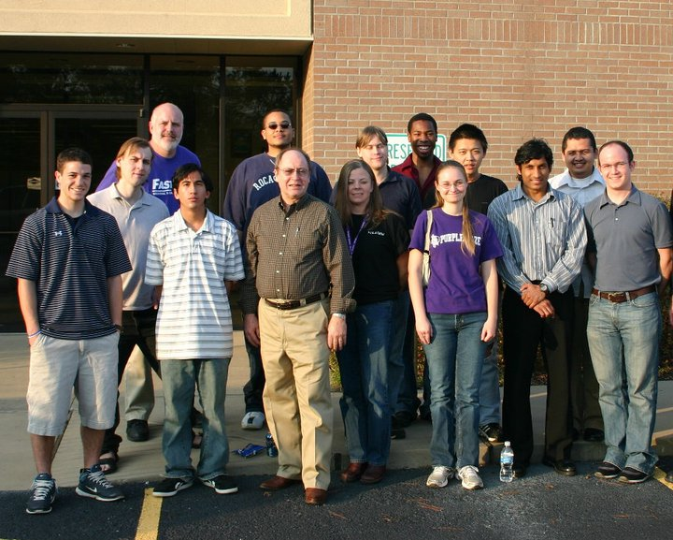
Computer Science Club
Department of Computer Science
Next Meeting: Fri, Sep 6 @ 5:30pm, McGee 303

Slide 26
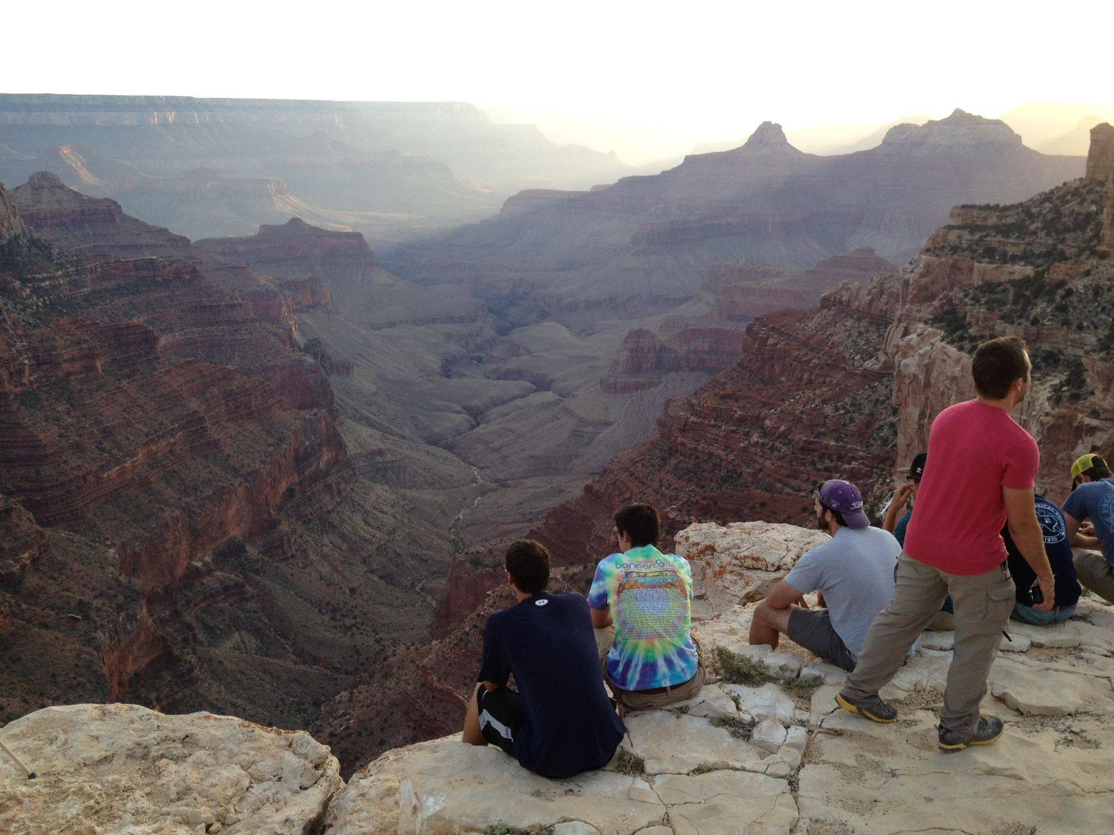
American Association of Petroleum Geologists (AAPG)
Assoc. of Environmental & Engineering Geologists (AEG)
Department of Geology
Next Meeting: Wed, Sep 11 @ 12pm Miller 335

Slide 27
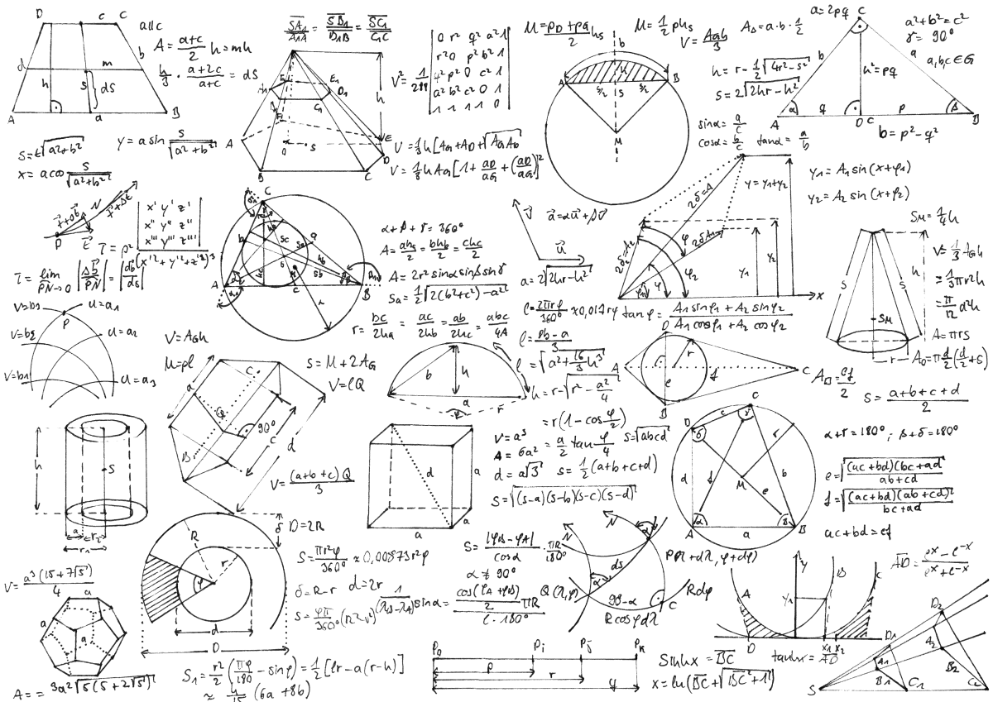
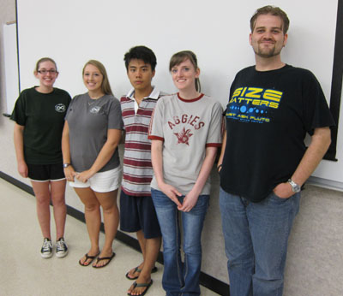
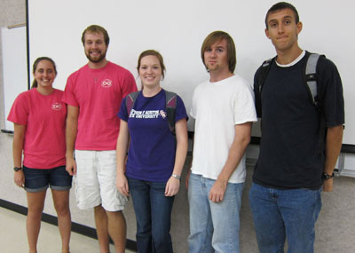
Math Club
Department of Mathematics and Statistics
Next Meeting: Fri, Sep 6 @ 2pm, Math 101

Slide 28
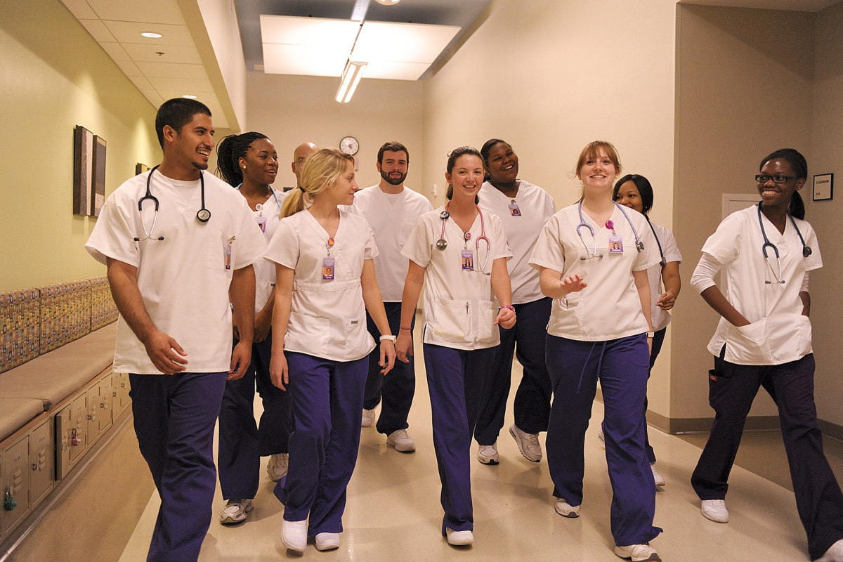
Student Nurses Association (SNA)
School of Nursing
Next Meeting: Mon, Sep 9 @ 7pm, School of Nursing

Slide 29

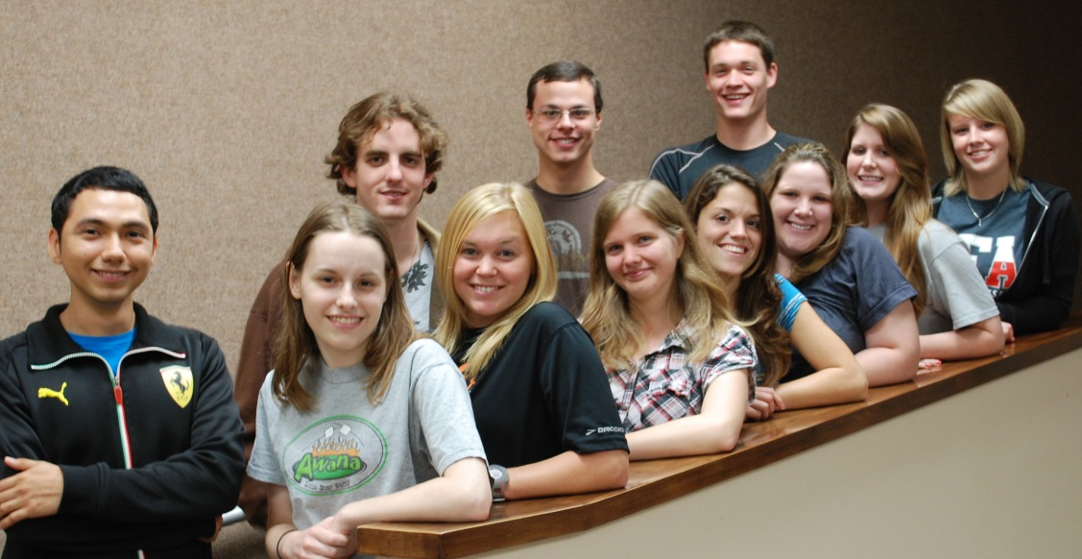

American Medical Student Association (AMSA)
Department of Biology
Next Meeting: Tues, Sep 10 @ 7pm Miller 139

Slide 30
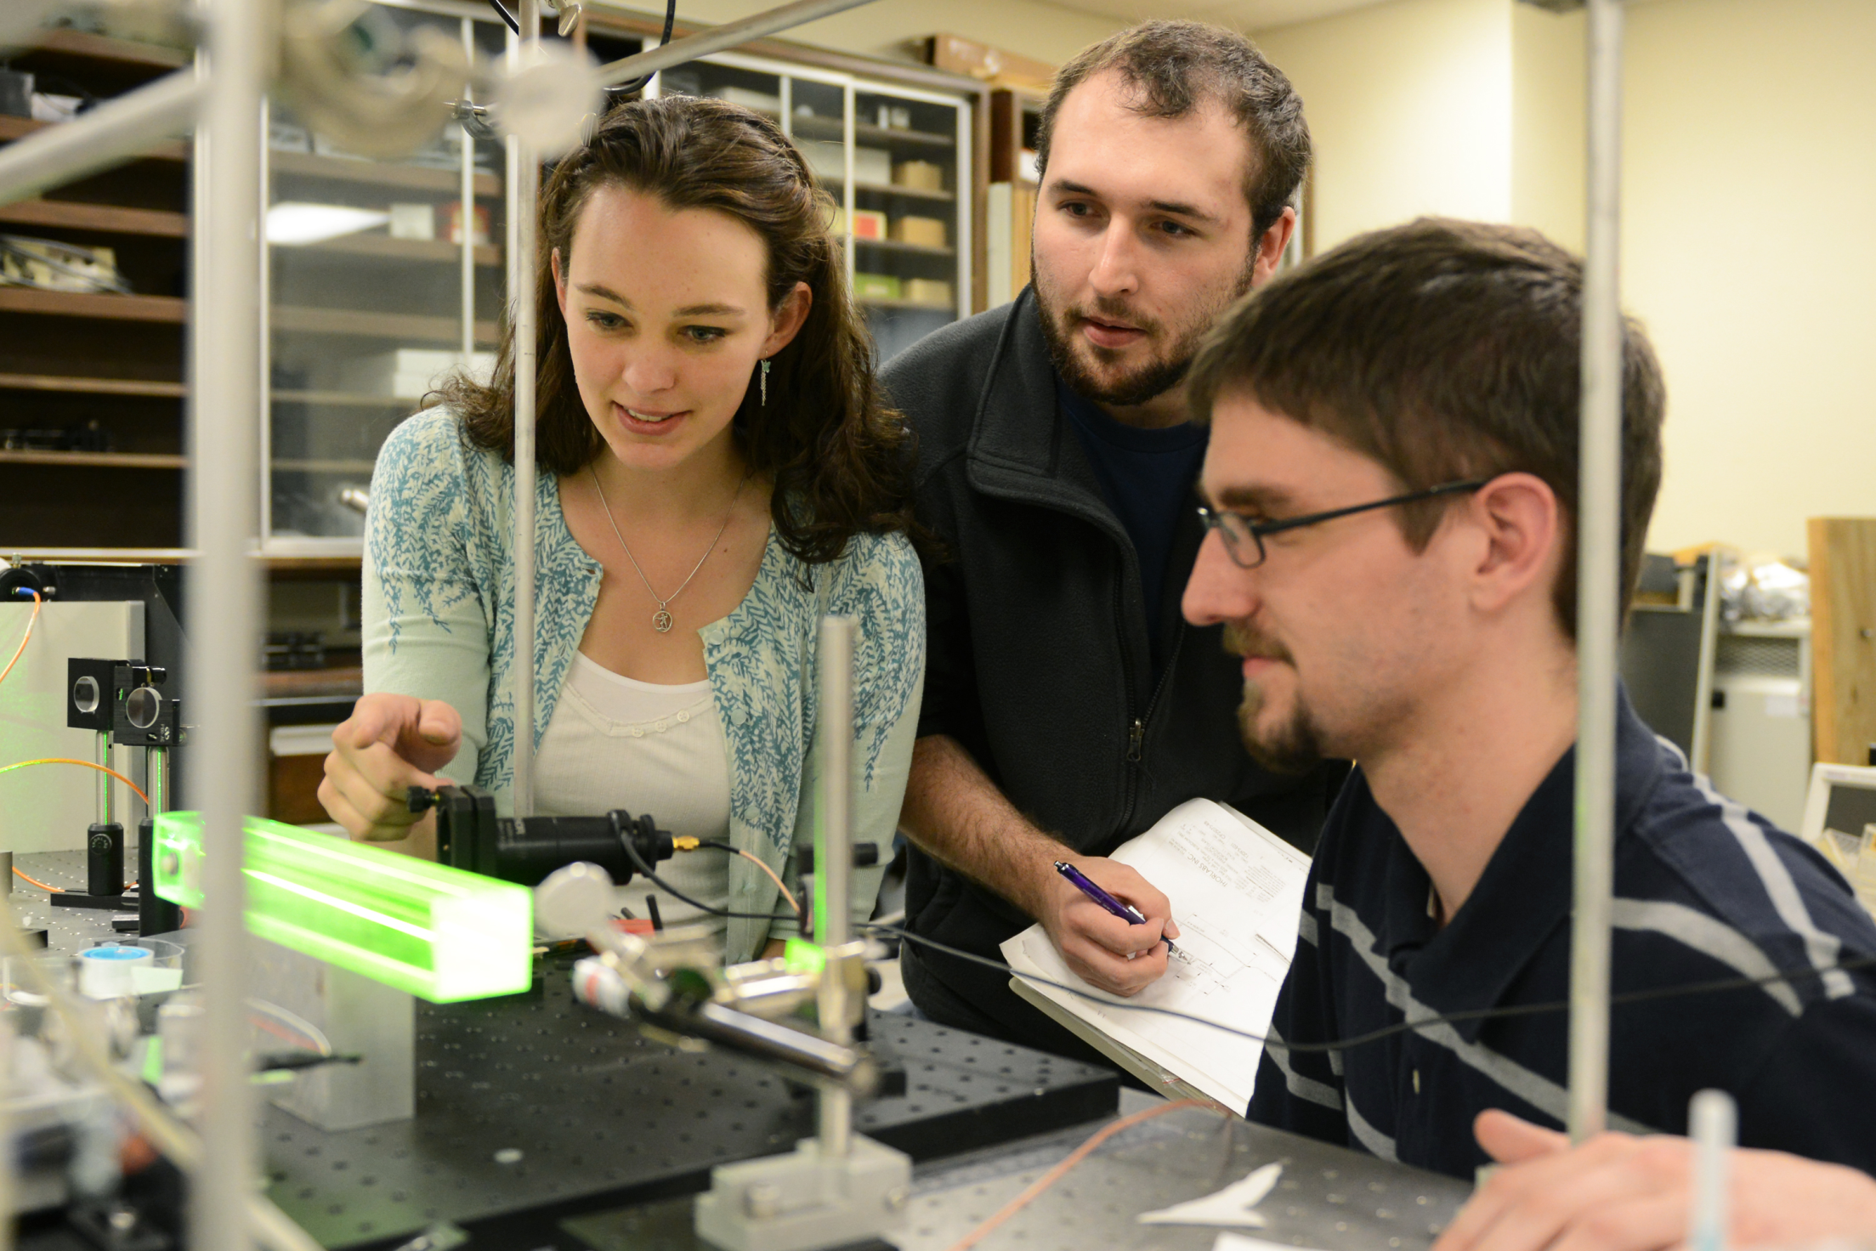
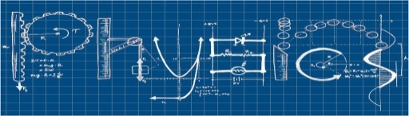
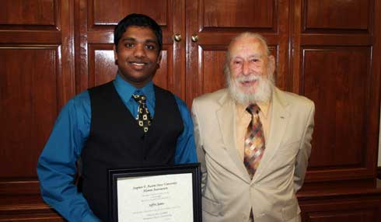
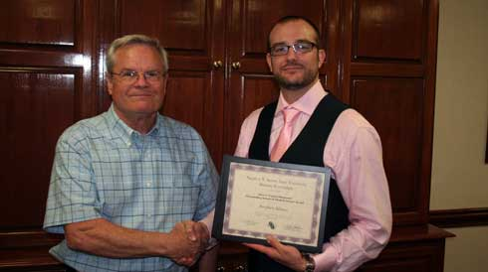
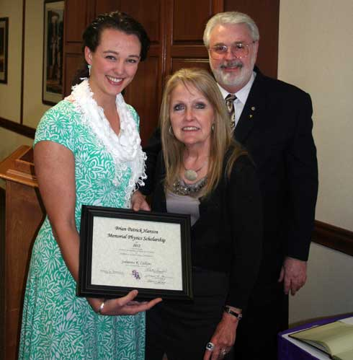
Society of Physics Students
Department of Physics and Astronomy
Next Meeting: Thurs, Sep 11 @ 5pm Miller 323

Slide 31
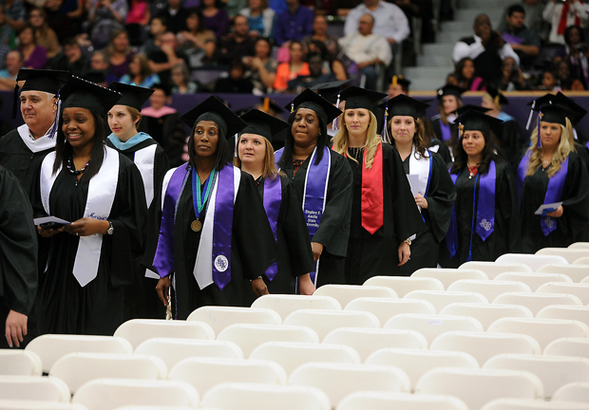
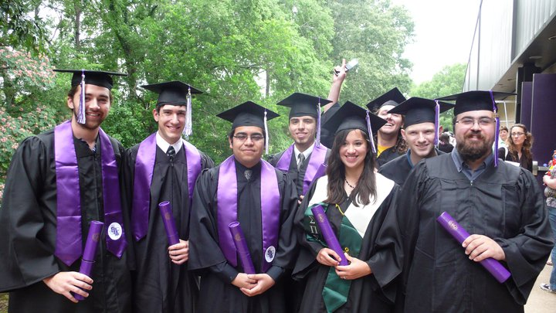
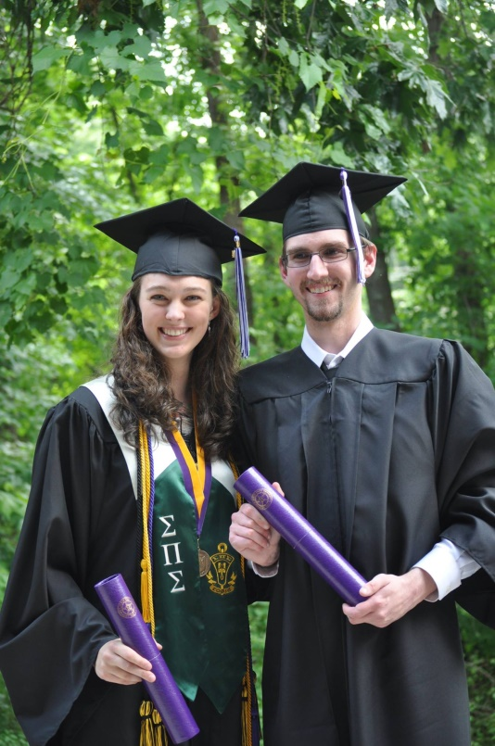
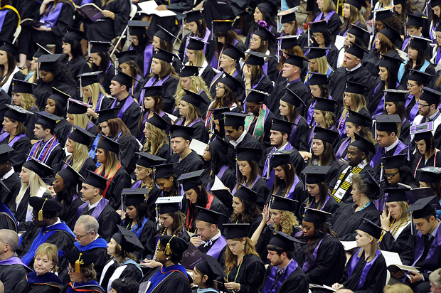
STEM Graduates

Slide 32
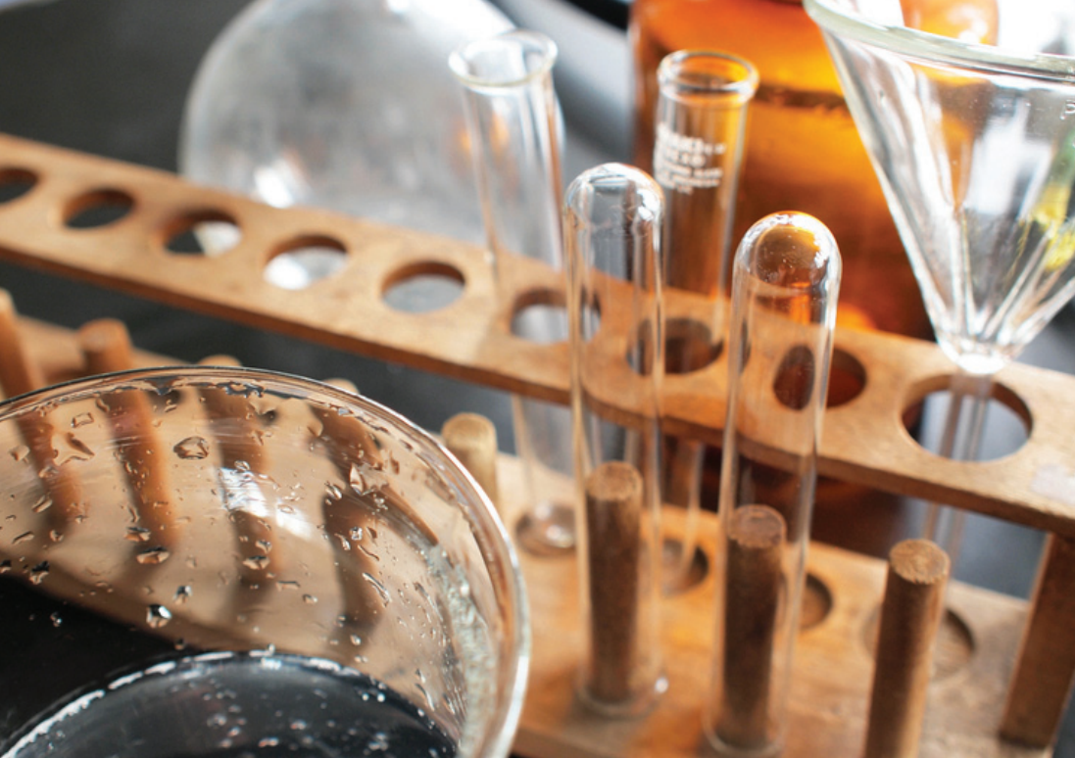
Students in the College of Sciences and Mathematics benefit from dedicated professors, small class sizes and unique opportunities to engage in research projects with STEM faculty members.

